Slide 1
BLE BASED Face secure SOFTWARE ARCHITECTURE
Jianfeng qin
CHRIS RIVERA
DongshenG zhang
V1.0
may, 2019

Slide 2
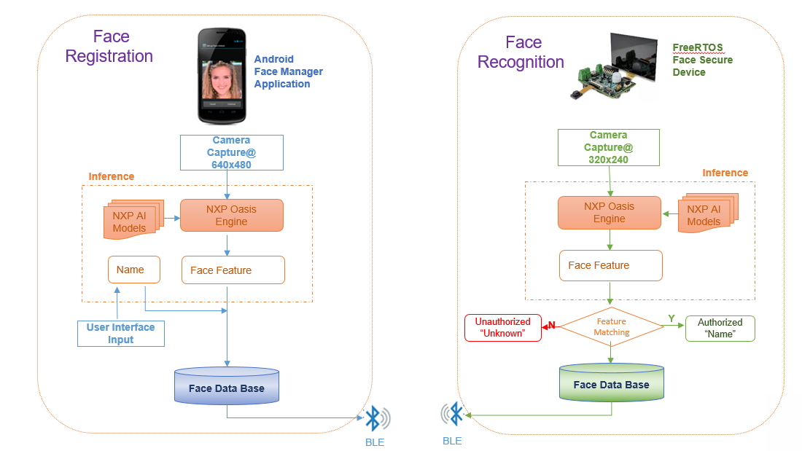
Architecture:

Slide 3
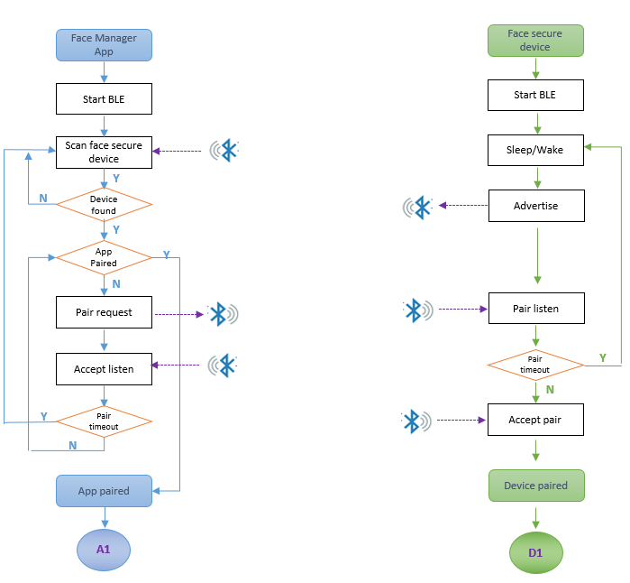
Flow: BLE PARING

Slide 4
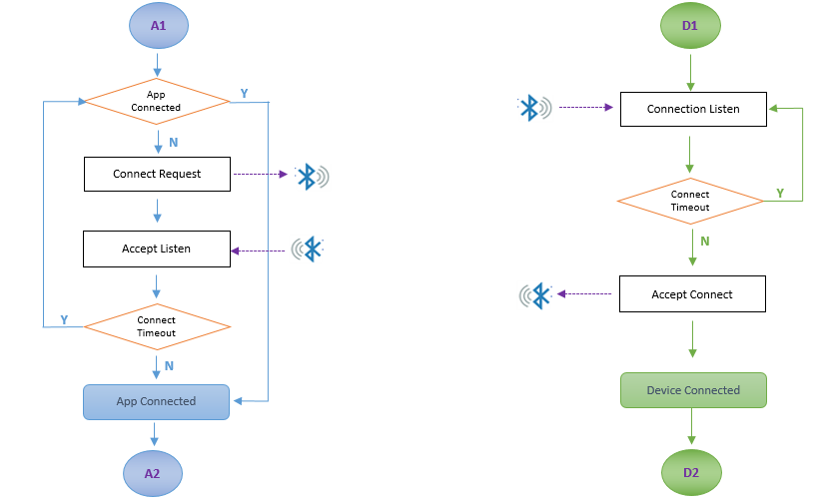
Flow: BLE CONECTION

Slide 5
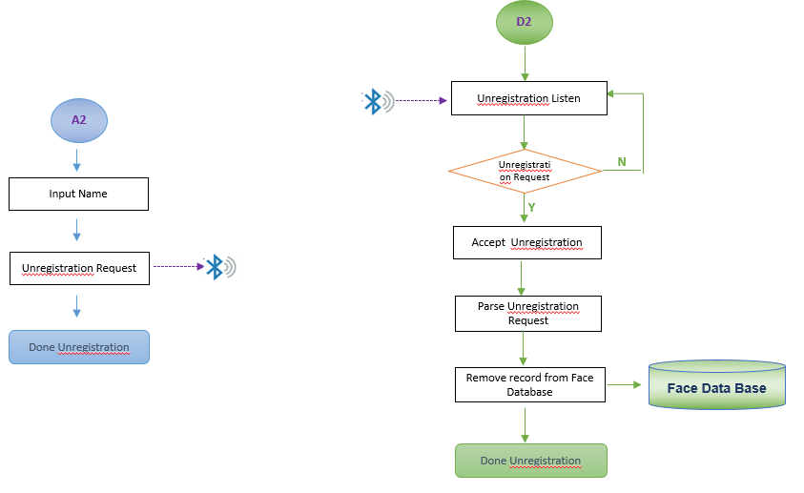
Flow: FACE registration By Phone Camera

Slide 6
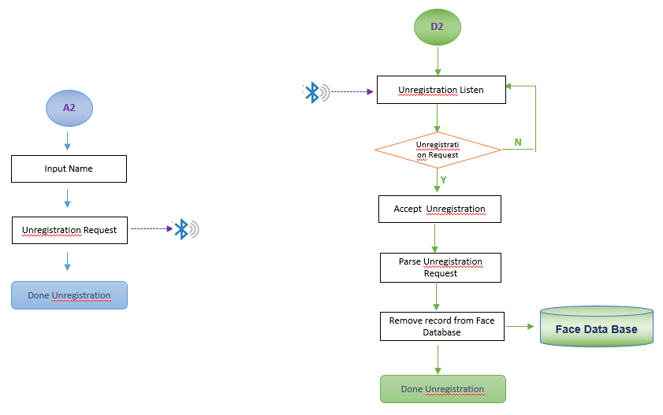
Flow: Face UNREGISTRATION

Slide 7
BACKUP

